Slide 1
Smart-Recovery Portal

Slide 2
Approve Phase 1 of the Smart-Recovery Portal
Automate simple self-serve debt recovery journeys such as pay now, promise-to-pay (PTP), and payment-plan selection. While routing unsupported cases to agents with full context, so an audit trail is included from day one.
Notes:
We are asking for approval to build and pilot Phase 1 of the Smart-Recovery Portal. The scope is deliberately narrow. We are not trying to automate everything; we are targeting the high-volume, rules-driven journeys that currently consume agent time without requiring their judgement. The case for doing this now is that the operational waste of the status quo is measurable and growing.

Slide 3
Why the problem matters now?
Legacy-Trust Bank
15% Revenue Leakage
Manual Operational Waste
100,000 Delinquent accounts
Agents spend most of their day on low-value tasks
Current process does not scale
In three months:
331 accounts in 'plan requested'
142 accounts in 'promise due' for over 30 days
Missed follow-ups directly contribute to revenue leakage
Notes:
The collections team is managing a high and growing volume of delinquent accounts through a process that was never designed for this scale. The waste is not small. 331 accounts are waiting for a plan whilst not repaying, and 142 broken promises are going unactioned for months. Every week that continues is recoverable revenue that is not being recovered. The current process does not scale. As volume grows, manual effort grows with it.

Slide 4
Discovery evidence
Legacy-Trust Bank
Pain Points
JTBD Themes
1 - No single source of truth.
1 - Customers want to self-serve without calling
2 - Follow-ups and PTP tracking is entirely manual.
2 - Agents want context before they act
3- Straightforward and complex cases are handled in the same manual queue.
3 - Managers want visibility without manual reporting.
Notes:
Discovery confirmed three things. First, the data problem. There is no reliable single version of account status, which means agents and managers are working from different versions of the same spreadsheet, leading to duplicate contact and missed follow-ups.. Second, the follow-up problem. The current process has no mechanism for automatically following up and catching broken promises. This has led to broken promises sitting unactioned for up to 120 days. Third, the prioritisation problem. Agents are spending time on cases that a portal could resolve, at the expense of cases that genuinely need them.

Slide 5
Value case:
Legacy-Trust Bank
Opportunities to automate:
Payment processing
Interaction history tracking
PTP tracking
Payment plan activation
Automated follow-ups
Assumptions:
Strongest assumption: the scale of the problem
Legacy data being complete enough to build on
Less certain of the portal’s impact on reducing low-value work
Notes:
Every opportunity on this slide was selected because it is high-volume and rules-driven and this means it can be automated without requiring human judgement.
Automated payment processing: removes delinquent cases from the manual queue entirely for straightforward, low-risk accounts.
Automated interaction history: removes manual data entry risk and ensures every customer touchpoint is logged accurately in real time.
Automated PTP tracker: provides visibility over PTP cases and prevents them being stagnant for up to 120 days, triggers escalation automatically
Payment plan activation: in three months there are 331 stalled accounts many of those being straight forward cases which could be solved by customers selecting their own payment plan.
Automated follow-ups: addresses the 15% revenue leak caused by missed or delayed follow-up appointments.
On assumptions: the strongest are the volume figures. The 331 stalled accounts and 142 overdue PTPs are confirmed from the delinquent accounts spreadsheet, so the scale of the problem is not in question. Where we are less certain is on agent time saved. The central assumption of the value case is that automating these journeys frees agents to focus on high-complexity cases. That is logical, but it has not been tested yet. Agents may find other ways to fill that time, the portal may generate new queries, or adoption may be slower than expected. This is the assumption that needs post-launch evidence to validate and support Phase 1 impact.

Slide 6
Phase 1 scope and exclusions:
In scope
Out of scope
Legacy-Trust Bank
Identity verification
Account summary
PTP capture
Payment plan selection
Rules-based routing
Portal outcome reporting
Hardship assessment
Bespoke repayment negotiation
Legal escalation workflow
Core platform replacement
Notes:
Everything in scope is rules-driven and can be built, tested, and governed without human judgement. I've also included portal outcome reporting from the start to give the business observable metrics early and satisfy the auditing requirement that financial stakeholders are looking for.
Everything out of scope requires contextual decision-making that automation cannot reliably replicate. Keeping this agent-led ensures the bank maintains regulatory compliance and avoids false positive errors that could occur with premature automation of complex legal statuses.

Slide 7
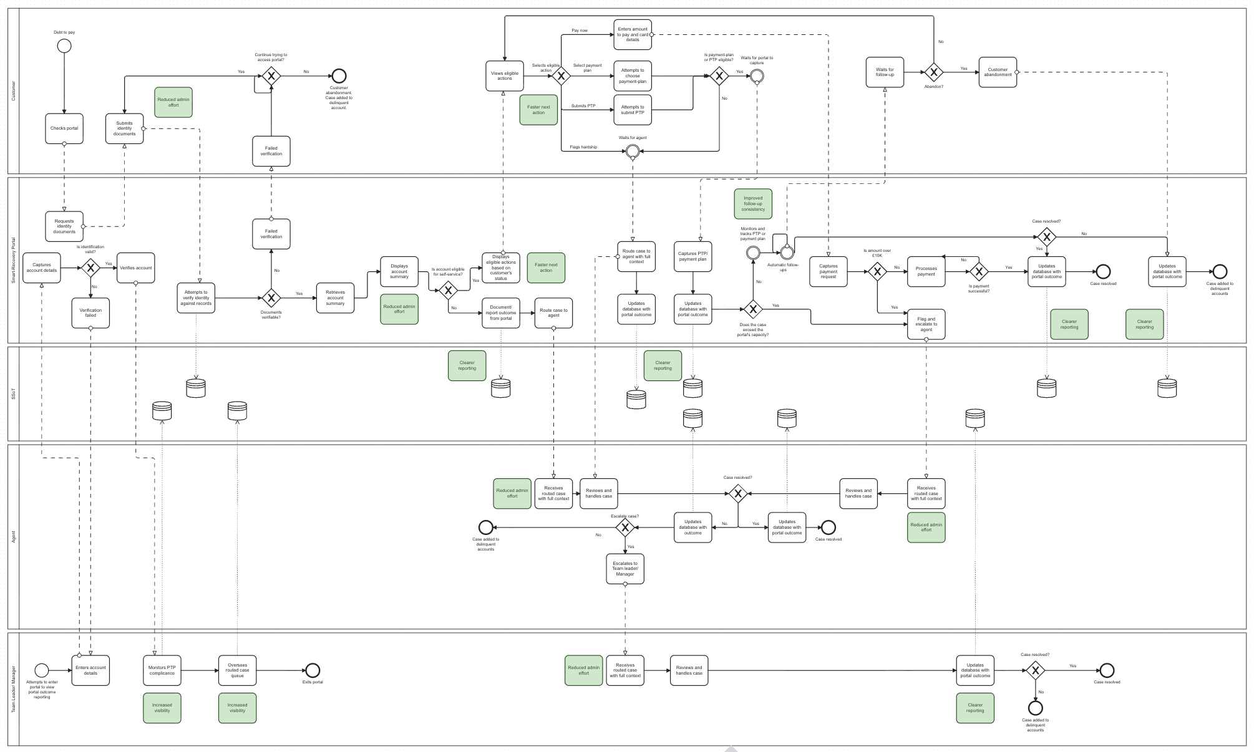
To-Be Workflow:
Notes:
Core journey: customer enters portal, verifies identity, views account summary, selects eligible action, receives confirmation or next steps
Exception path: ineligible or complex cases routed to agent automatically with full interaction log, escalation reason, and account status
Reporting: every stage transition logged automatically, visible to managers in real time
Handoff point clearly marked. Agent receives case with full context, no reconstruction required.
The workflow has two outcomes: self-service resolution or a clean handoff to an agent. The handoff is as important as the resolution. If an agent receives a routed case without context, they will distrust the system and work around it. The design ensures that every case that reaches a human arrives with everything that person needs to act immediately. Reporting is not retrofitted. It is built into every stage transition from day one.

Slide 8
Delivery readiness:
15 user stories across 5 epics
Legacy-Trust Bank
Identity verification
Account visibility and eligible actions options
Payment-plan selection
Rules-based routing and exception handling
Portal outcome reporting and audit trail
Low-fidelity prototype covers all core screens: landing, verification, account summary, action selection, PTP, payment plan, confirmation, routed-to-agent
Exception handling: failed verification
Key dependencies: legacy data accessibility, compliance sign-off on audit trail, agent workflow alignment for routed cases
Notes:
Stories prioritised, written with acceptance criteria and dependencies.
This backlog is 15 user stories with defined acceptance criteria that a delivery team can pick up and act on. The prototype makes the customer journey visible to reviewers without requiring imagination. The three dependencies are flagged because they sit outside the delivery team's control and need confirming before build begins. None of them are blockers today, but all of them could become blockers if left unresolved.

Slide 9
Change risks and mitigations:
ADKAR assessment
Legacy-Trust Bank
Risk 1: Agent adoption risk
Risk 2: Poor visibility over portal impact
Risk 3 Lack of structured evidence before Phase 2
Notes:
Risk 1: Agents distrust routed case quality and revert to manual workarounds. Mitigation: UAT involvement before launch, handoff context specified in acceptance criteria.
Risk 2: Managers cannot see where work is going post-launch. Mitigation: reporting dashboard in Phase 1 scope, not Phase 2.
Risk 3: Leadership loses confidence before Phase 2 without structured evidence. Mitigation: success metrics defined now, reporting cadence agreed before launch.
All three mitigations are already reflected in scope or backlog.

Slide 10
Approval ask:
Approve Phase 1 Pilot Mobilisation
Legacy-Trust Bank
Confirm scope, unblock the three dependencies, and agree success metrics
Next steps if approved: dependency confirmation within one week / backlog refinement with delivery team
Notes:
We are asking for approval to mobilise a pilot on a scope that is already defined, with a backlog that is already written and a prototype that is already reviewable. The three dependencies need owners assigned today. If they are confirmed within the week, we can begin backlog refinement immediately.

Slide 11
An important lesson from similar projects in the past
Company Name
Quarter
Month Year
KEY LEARNING 1
Share something the team has learned from previous projects of comparable scope, topic, or deliverables.
KEY LEARNING 2
You can mention processes, actions, or strategies you want to emulate in the current project — or avoid.
KEY LEARNING 3
Add as many items as you want. Make sure they are relevant to the project you’re about to undertake.

Slide 12
An important lesson from similar projects in the past
Company Name
Quarter
Month Year
KEY LEARNING 1
KEY LEARNING 2
KEY LEARNING 3
Share something the team has learned from previous projects of comparable scope, topic, or deliverables.
You can mention processes, actions, or strategies you want to emulate in the current project — or avoid.
Add as many items as you want. Make sure they are relevant to the project you’re about to undertake.

Slide 13
Tools and resources
Company Name
Quarter
Month Year
Give the team everything they need to get started. Share external decks, briefs, style guides, guidelines, and other tools and resources below.
Resource name
Resource name
Resource name
Resource name
Briefly describe the resource and why it’s useful. Then link to it.
Briefly describe the resource and why it’s useful. Then link to it.
Briefly describe the resource and why it’s useful. Then link to it.
Briefly describe the resource and why it’s useful. Then link to it.

Slide 14
Next
steps
Company Name
Quarter
Month Year
01.
02.
03.
04.
Describe an upcoming step or deadline in your project.
These can include meetings, deliverables, check-ins, etc.
Use this slide for short-term or immediate steps and deadlines.
Use the charts in the previous slides for your full project calendar.

Slide 15
Any questions? Ask away!
Give your audience space to resolve doubts or concerns. Open up the discussion before ending the meeting.

Slide 16
Thank you
Company Name
Quarter
Month Year

